Slide 1
Neeley Analytics Initiative
Dr. Justin Keeler
Clinical Associate Professor of Business Analytics

Slide 2
Time Planning
Part 1: 08:30-09:45 (1.25) [Supervised Machine Learning]
Part 2: 10:00-11:00 (1.00) [Classification Exercise]
Part 3: 11:15-12:00 (0.75) [Analytic Software Introduction]
Lunch: 12:00-13:00
Part 4: 13:30-14:30 (1.00) [Model Refinement & Performance Evaluation]

Slide 3
Part 1: Session Overview
Examine what is meant by supervised machine learning.
Assess applications of supervised machine learning.

Slide 4
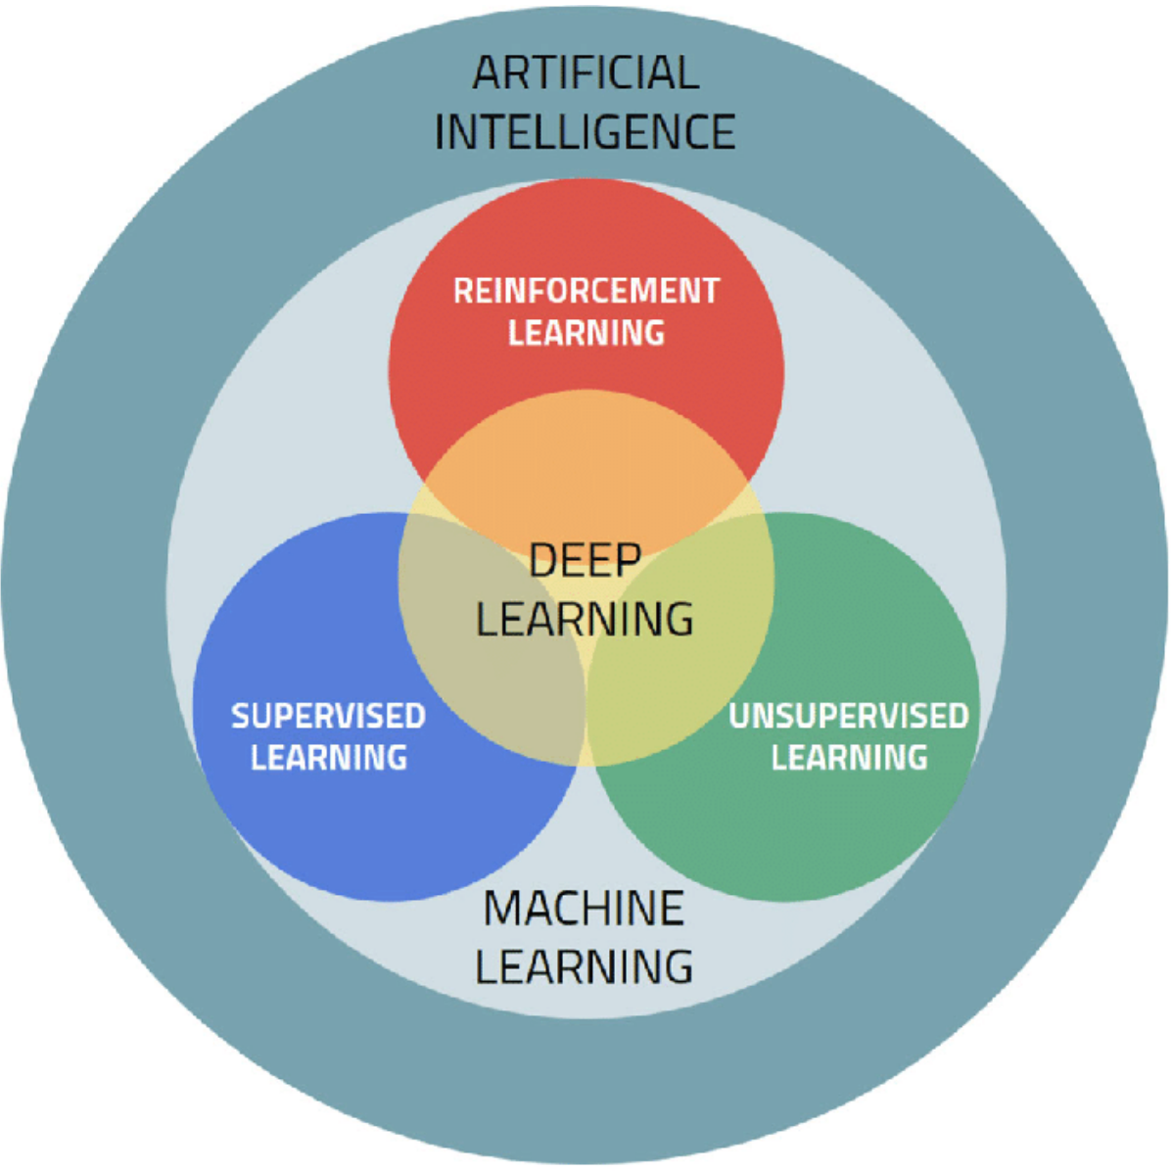
AI, ML, DL Relationship
ARTIFICIAL INTELLIGENCE
The goal is to simulate natural intelligence to resolve an advanced problem.
MACHINE LEARNING
The goal is to use knowledge/data to maximize the performance of the machine on the task.
DEEP LEARNING
The goal is to use knowledge/data to maximize the performance of the machine on the task.

Slide 5
Sophia “First Robot with Citizenship”
https://www.youtube.com/watch?v=Sq36J9pNaEo

Slide 6
ML vs DL
Machine learning algorithms leverage structured, labeled data to make predictions—meaning that specific features are defined from the input data for the model and organized into tables. This doesn’t necessarily mean that it doesn’t use unstructured data; it just means that if it does, it generally goes through some pre-processing to organize it into a structured format.
Deep learning eliminates some of data pre-processing that is typically involved with machine learning. These algorithms can ingest and process unstructured data, like text and images, and it automates feature extraction, removing some of the dependency on human experts. For example, let’s say that we had a set of photos of different pets, and we wanted to categorize by “cat”, “dog”, “hamster”, et cetera. Deep learning algorithms can determine which features (e.g. ears) are most important to distinguish each animal from another. In machine learning, this hierarchy of features is established manually by a human expert.

Slide 7
Deep Learning Applications
Healthcare: Today’s medical industry is generating vast amounts of data. Being able to quickly and accurately analyze this data can contribute to improved patient outcomes in a number of ways. Deep learning algorithms are being applied in areas such as medical research, imaging analytics, disease prevention, guided drug development, and natural language processing—which can be especially helpful for filling in free text clinical notes in electronic health records (EHRs).
Manufacturing: Manufacturers need to deliver higher quality products and services faster and with lower costs. Many companies are adopting computer-aided engineering (CAE) to reduce the time, expense, and materials needed to develop physical prototypes to test new products. Deep learning can be used to model very complex patterns in multidimensional data and improve the analytics accuracy of testing data.
Financial services: Fraud is a growing problem in many industries, but particularly so for financial service providers. Deep learning can be used to identify out-of-pattern behavior quickly and cost-effectively. Insights delivered from deep learning models can also help more accurately evaluate the credit risk of a loan applicant, predict stock values, automate back-office operations, and advise clients on financial products.
Public sector: As more departments, systems, and processes become digitized, government agencies can use deep learning to increase automation and make civil servants more efficient. Image detection and classification can make it easier for law enforcement to find persons of interest in public spaces. Visa and immigration applications can be streamlined with algorithms to automate certain aspects of processing. Airports are using deep learning to improve security, enhance operations, and automate queue management. Deep learning models can even be used to help predict traffic conditions and allow local authorities to take proactive steps to ease road congestion.

Slide 8
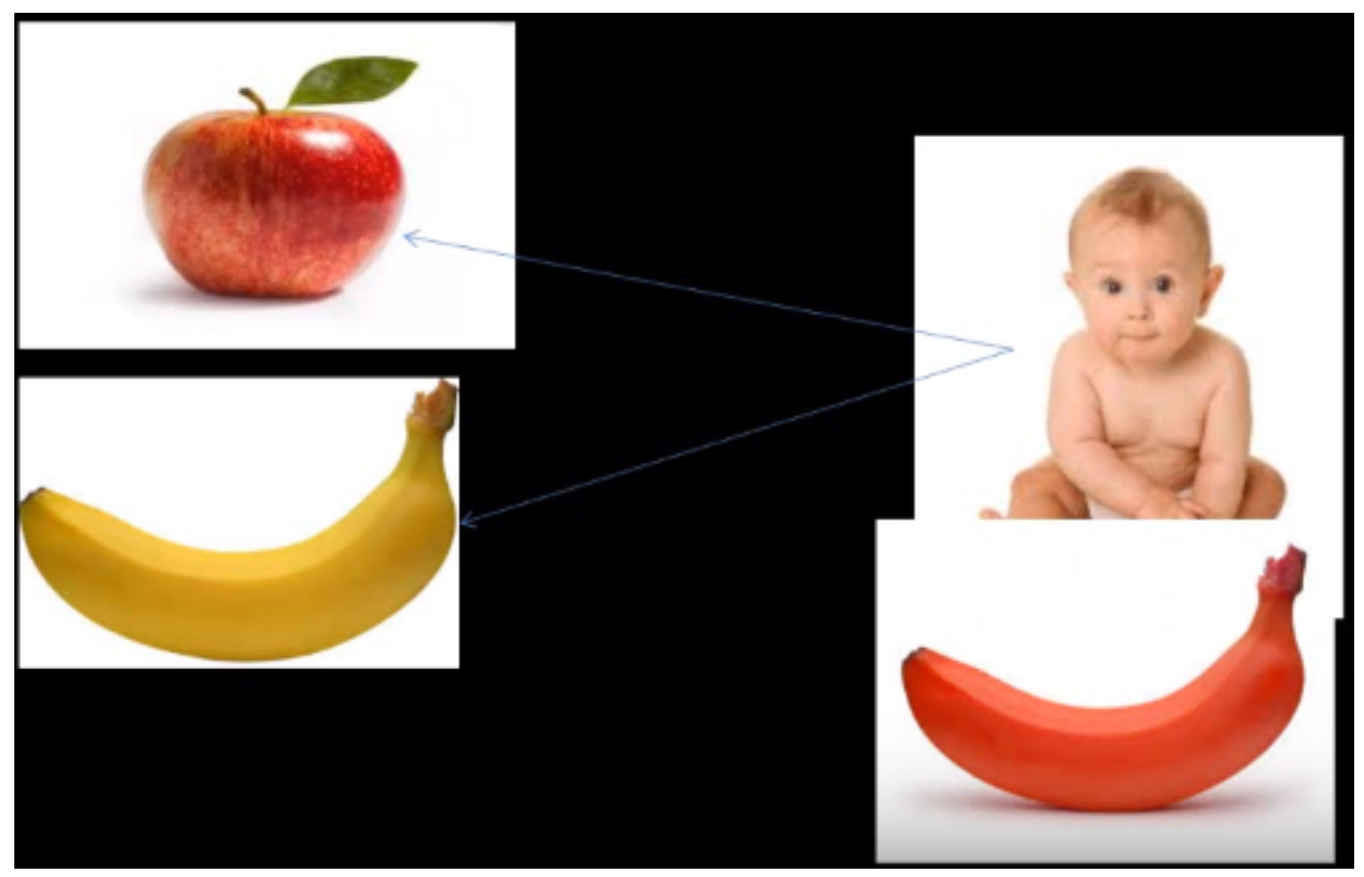
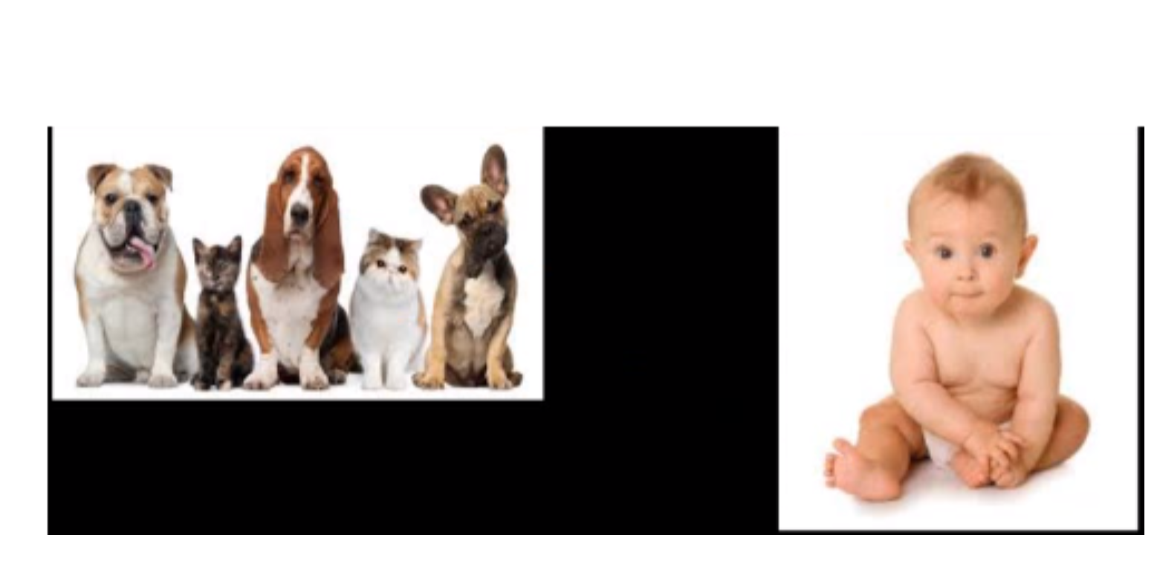
Machine Learning Type Comparison
Supervised learning utilizes labeled datasets to categorize or make predictions; this requires some kind of human intervention to label input data correctly.
Unsupervised learning doesn’t require labeled datasets, and instead, it detects patterns in the data, clustering them by any distinguishing characteristics.
Reinforcement learning is a process in which a model learns to become more accurate for performing an action in an environment based on feedback in order to maximize the reward.

Slide 9
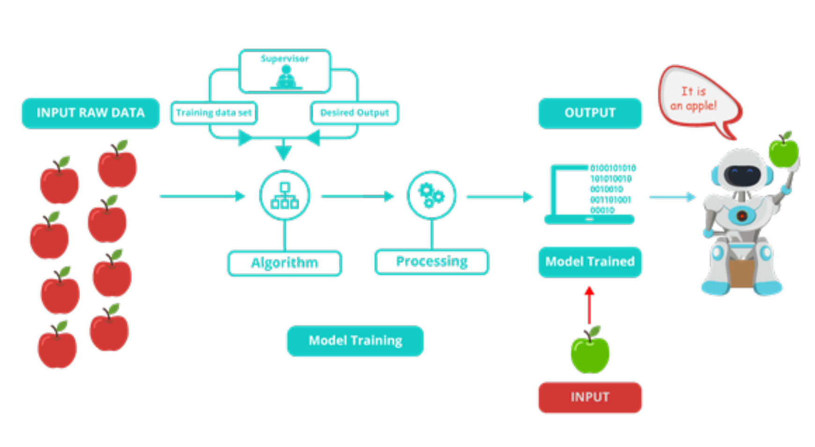
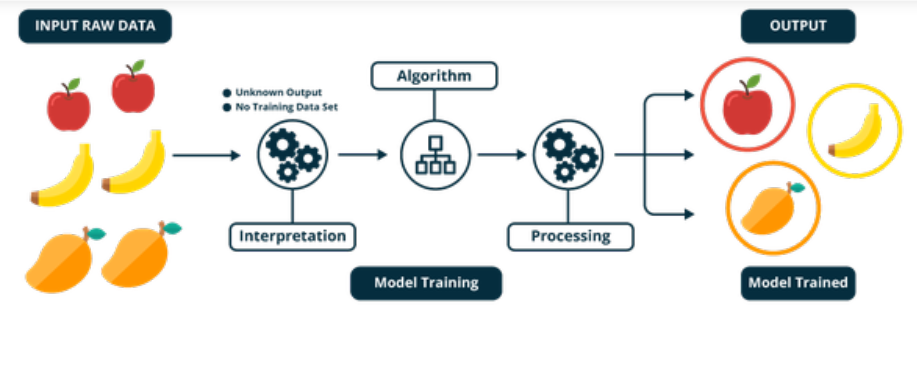
Supervised vs. Unsupervised
Unsupervised
Supervised

Slide 10
Supervised Learning - Expanded
Supervised learning
Each data point is labeled or associated with a category or value of interest.
Examples:
Categorical label is assigning an image as either a ‘cat’ or a ‘dog’. An example of a value label is the sale price associated with a used car. Identifying new photos with the correct animal or assigning accurate sale prices to other used cars.
Goal: To study many labeled inputs and make predictions about future data points.

Slide 11
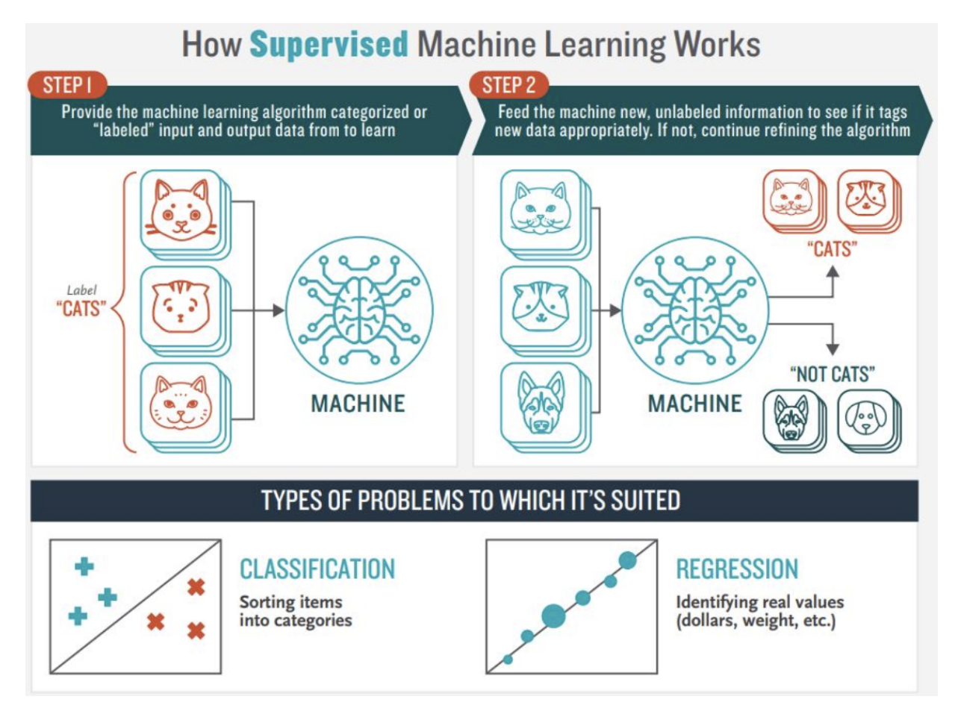
Supervised Machine Learning FLow

Slide 12
Interactive Exercise
Text

Slide 13
Title
Text

Slide 14
What do you remember?
Text

Slide 15
Break Time!

Slide 16
Part 2: Session Overview
Classifying Categorical Outcomes with k-Nearest Neighbors:
A nearest-neighbor classifier is a “lazy learner” that directly uses the entire training set to classify observations in the validation and test sets.
The value of k can plausibly range from 1 to n, the number of observations in the training set.
If k = 1, then the classification of a new observation is set to be equal to the class of the single most similar observation from the training set.
If k = n, then the new observation’s class is naïvely assigned to the most common class in the training set.

Slide 17
Part 2: The Plan
Apply basic calculations of a classification algorithm, specifically k-NN
NN = Nearest Neighbors
Use two features and one target

Slide 18
Data Set
Observation | Average Balance | Age | Loan Default
1 | 49 | 38 | 1
2 | 671 | 35 | 1
3 | 772 | 47 | 1
4 | 136 | 48 | 1
5 | 123 | 40 | 1
6 | 900 | 29 | 0
7 | 1,500 | 38 | 0
8 | 2,300 | 35 | 0
9 | 2,200 | 58 | 0
10 | 2,100 | 30 | 0
Average
Standard Dev.

Slide 19
Loan Default – Yes/No

Slide 20
Questions/Application
Create the coordinates for the following customers:
Cust #1: Avg Bal = 20, Age = 50
Cust #2: Avg Bal = 700, Age = 40
Cust #3: Avg Bal = 175, Age 28
Based on 1,2,3 k-nn, is Cust 1, 2, and 3 most likely to default or not default on their loan.
Which k-nn do you think is most appropriate to apply for the Customers? Explain why.

Slide 21
Where might Customers 1, 2, and 3 be?

Slide 22
What do you think about Customers 1, 2, and 3?

Slide 23
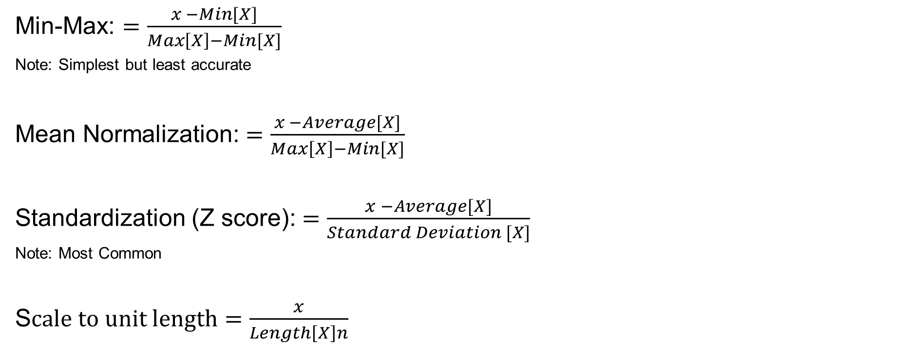
Feature Scaling Methods
Min-Max: $=\frac{x −Min[X]}{Max\left[X\right]−Min[X]}$
Note: Simplest but least accurate
Mean Normalization: $=\frac{x −Average[X]}{Max\left[X\right]−Min[X]}$
Standardization (Z score): $=\frac{x −Average[X]}{Standard Deviation [X]}$
Note: Most Common
S$cale to unit length=\frac{x}{Length\left[X\right]n}$

Slide 24
Z Values for Coordinates
Observation | Average Balance | Age | Loan Default
1 | -1.247 | -0.124 | 1
2 | -0.519 | -0.466 | 1
3 | -0.400 | 0.901 | 1
4 | -1.145 | 1.015 | 1
5 | -1.161 | 0.104 | 1
6 | -0.250 | -1.149 | 0
7 | 0.452 | -0.124 | 0
8 | 1.390 | -0.466 | 0
9 | 1.272 | 2.154 | 0
10 | 1.155 | -1.035 | 0

Slide 25
Z Score Plot

Slide 26
Break Time!

Slide 27
Part 3: Session Overview
Analytic Software Overview
Python
R
Mplus
SPSS/AMOS
Alteryx
SAS/JMP
Jupyter Notebooks, Spyder, PyTorch, Colabs (IDEs)
Why not just use Excel?

Slide 28
Python
Open Source (Netherlands)
Platforms: Atom, Powershell, IDEs
Used by NASA, Amazon, Google, Netflix, etc
Industries: Corporate/Education/Scientific Research

Slide 29
R
Open Source (University of Auckland, New Zealand)
Platforms: R, R Commander
Used by Accenture, Amazon, Google, Novartis
Industries: Corporate/Education/Scientific Research

Slide 30
Mplus
Fee-Based (UCLA, Los Angeles) https://www.statmodel.com/
Platforms: Mplus
Industries: Primarily Scientific Research/Education

Slide 31
SPSS/AMOS
Fee-Based (IBM)
Platforms: SPSS/AMOS
Industries: Primarily Scientific Research/Education, some corporate

Slide 32
Alteryx
Fee-Based (Irvine, CA)
Platforms: Alteryx
Industries: Primarily corporate

Slide 33
SAS/JMP
Fee-Based (North Carolina)
Platforms: SAS
Industries: Primarily corporate, some educational

Slide 34
IDEs
Why do things such as Integrated Development Environments exist?
Allow flexibility for quantitative lifting (computer resource usage), GUI aesthetic customization, specifically related to open-source software.
IDEs can be locally installed (Atom, Powershell) or cloud-based (Jupyter Notebooks, Google Colab).
Provides forgiveness and assistances when scripting.

Slide 35
Resources
Stackoverflow (https://stackoverflow.com/)
Medium (https://medium.com/tag/data-analysis)
Github (https://github.com/)

Slide 36
Part 4: Session Overview
Explore how models are evaluated and fine-tuned for performance assessment.

Slide 37
Title
Text

Slide 38
Title
Text

Slide 39
Title
Text

Slide 40
Title
Text

Slide 41
Title
Text

Slide 42
Title
Text

Slide 43
Title
Text

Slide 44
Title
Text

Slide 45
Title
Text

Slide 46
Title
Text

